Slide 1
Capstone Project on Market Value Estimation of Football Players submitted by 1. Manvir Singh Kohli – Roll No. 725QXVGQ2O 2. Abhishek Sharma – Roll No.EU6UKFRTGH 3. Akansha Gupta – Roll No. FMSWB7IHPO 4. Kunal Malik – Roll No. F4MZM1ML6W under the guidance of Mr. Pranov Mishra Batch – (PGPBABI.G.Sep’19)

Slide 2
Introduction

Slide 3
Football is the most popular sport in the world.
Approximately 3.5 billion worldwide viewers of the sport.
Approximately 265 million (4% of the world population) participants - either as players or as referees.
With the vast viewership, football clubs represent a huge business opportunity for their owners.
There are various ways in which a football club makes money -
Matchday revenue (from ticket sales)
Broadcasting rights
Sponsorships and Merchandise sales

Slide 4
At the heart of this money minting business are the clubs’ most important assets – their players.
Th market value of a player is the amount of money paid by one club to acquire him/her from another club.
In the 2018-19 season , the top 5 spending clubs spent a total of €1074.50 million on the purchase of football players.
Since the trade of football players between clubs involve huge sums of money therefore, a misevaluation of a player’s worth can result in huge financial losses for the clubs.
Thus, it seems an interesting prospect to understand what aspects of a player determine his market value.

Slide 5
Objective & Methodology

Slide 6
The objective of the project is to build a machine learning algorithm and that can predict the market value of football players with maximum accuracy
The project also attempts to analyze and find out which features significantly determine the value of a footballer.
This model is built based on attributes of 4705 players across the top 10 football leagues.
The attributes cover the attacking and defending skillsets of a player as per the game EA FIFA 20 along with certain real-life performance metrics in the 2018-2019 season. (Please note that the stats provided to the player in the FIFA 20 game are based on the performance in the 2018-2019 season.)
Further the model will focus only on outfield players, meaning players playing in all positions except goalkeepers. This is because goalkeepers have a completely different set of attributes and cannot be directly compared with outfield players.

Slide 7
Yes
No

Slide 8
Tools and techniques used

Slide 9
Technique | Tool | Purpose
Data Collection | Chrome and Python (Selenium) and Alteryx | Downloading (partial) data from Kaggle and scraping the rest from www.whoscored.com and then combining the data using Alteryx.
Data Pre-Processing and Exploratory Data Analysis | R, R Studio, Python | Performing descriptive statistics, data cleaning, null value handling outlier treatment and creation of visualizations for initial insights on data
Train and Test data split | R, R Studio, Python | Using random sampling to split the data into training and testing sets
Model Building | R, R Studio, Python | Building various predictive machine learning models and interpreting their results

Slide 10
Data Source and Description

Slide 11
Part of the data has been sourced from the Kaggle. The data on Kaggle was in turn obtained from the website www.sofifa.com. This part of the data contains each player’s gaming attributes as in the game of EA FIFA 20.
Some additional variables (not available in the Kaggle dataset) were also sourced from www.sofifa.com as well as www.whoscored.com. The data was scraped using a python script with the help of Selenium for python.
The data obtained from the two sources was then combined using an Alteryx workflow to get the final dataset which contains the details 4705 unique football players
Table 1 describes the variables obtained from Kaggle while table 2 describes the additional variables scraped from the websites ‘sofifa’ and ‘whoscored’.

Slide 12
Table 1 : Variables sourced from Kaggle
Variable Name | Variable Description
Value/Market_Value (used interchangeably) | Market value of the player in Euros as of 1st Oct 2019. This is the target variable
S.No. | Serial number of the observation
sofifa_id | Unique identifier of the player on www.sofifa.com
short_name | Player’s truncated name
long_name | Player’s full name
age | Age of the player
nationality | Nationality of the player
Player_Continent | The geographical continent to which the player belongs
Club_Continent | The geographical continent to which the player’s club belongs
Wages | Per week wage of the player in Euros for the season 2018-19 (ending in May’19)
Position_Final | The position in which the player plays
preferred_foot | Preferred foot of the player for kicking the ball
weak_foot | Weak foot rating on a scale of 1 to 5 as per the FIFA 20 Game
pace | The pace of the player on a scale of 100 as per the FIFA 20 game
shooting | The shooting accuracy of the player on a scale of 100 as per the FIFA 20 game
passing | The passing accuracy of the player on a scale of 100 as per the FIFA 20 game
dribbling | The dribbling skills of the player on a scale of 100 as per the FIFA 20 game
defending | The defending skills of the player on a scale of 100 as per the FIFA 20 game
physic | The physical strength of the player on a scale of 100 as per the FIFA 20 game

Slide 13
Table 2 : Variables sourced from ‘sofifa’ and ‘whoscored’
Variable Name | Variable Description
Club_Int_Prestige | The Clubs prestige rated from 1 to 10 amongst all the international clubs in world football, with 10 being the best rating possible
Club_Domestic_Prestige | The Clubs prestige rated from 1 to 10 amongst all the clubs within the league to which the club belongs, with 10 being the best rating possible
Player_international_reputation | Each player’s reputation on an international scale from 1 to 5 with 5 being the highest rating
Mins_Total | Total minutes of football played during the 2018-19 season
Goals_Total | No. of goals scored by the player during the 2018-19 season
Assists_Total | No. of assists provided by the player during the 2018-19 season. As assist is a pass that directly results in a goal
Shots_per_game_total | No. of shots attempted by a player per game during the 2018-19 season
Yellow_Cards_Total | No. of yellow cards obtained by the player for committing fouls during the 2018-19 season. A yellow card in a game represents a warning for foul play.
Red_Cards_Total | No. of red cards obtained by the player for committing fouls during the 2018-19 season. A red card may be obtained directly or by obtaining 2 yellow cards in the same game. While both kind of red cards involve the player being sent off in the current game , the former involves a suspension for 3 subsequent games whereas the latter involves a suspension for 1 subsequent game
Aerial_Battles_Won_Per_Game_Total | No. of headers won by a player per game throughout the 2019-19 season
Man_of_The_Match_Total | No. of man of the match accolades obtained by the player during the 2018-19 season

Slide 14
Data Preprocessing & Exploratory Data Analysis

Slide 15
Data Preprocessing
S.no. and so_fifa_id were read as numeric variables but were converted into character variables as these numbers have no meaning.
Nationality, Player_Continent, Club_Continent, preferred_foot, Position_Final were read by R as characters and were converted into factors
The variables Club_Int_Prestige, Club_Domestic_Prestige, Player_international_reputation , weak_foot, were read by R as numeric but it must be noted that these are ordinal variables.
Every other variable was read by R in the desired format
The data was checked for null values using the is.na () command in R. The result showed that there were no nulls in the dataset.

Slide 16
Exploratory Data Analysis
Univariate Analysis – Techniques Used
Univariate Analysis on non-ordinal numerical variables was performed using histograms and boxplots to identify outliers
The following method was used for outlier treatment:
Calculating the Interquartile range (IQR) i.e. the difference between quartile 3 (Q3) and quartile 1(Q1)
Setting the lower limits (LL) and upper limits (UL) for each variable equal to Q1 – 1.5*IQR and Q3 + 1.5*IQR respectively
Any value below the lower limit or above the upper limit was considered an outlier and was replaced with the lower limit or the upper limit respectively.
However, based on knowledge about the sport, certain features like Goals_Total and Assists_total are extremely important in considering a player’s worth and their extreme values can contain important explanatory powers. Hence it may be worth exploring the behavior of these variables in the models both with and without outlier treatment.
For ordinal variables as well as for categorical variables , bar plots were drawn to check the count of observations in each rank or category respectively

Slide 17
Exploratory Data Analysis (contd.)
Bivariate Analysis – Techniques Used
For numerical variables , bivariate analysis involved checking correlation and VIF for multicollinearity and drawing scatterplots.
Depending on the nature of the numeric variables, different measures of correlation can be used as follows :
Continuous vs Continuous: Pearson Correlation
Continuous vs Ordinal: Spearman Correlation
Ordinal vs Ordinal: Spearman Correlation
For bivariate analysis of categorical variables , stacked bar charts and cross tabulations were drawn
In addition to above techniques , boxplots were made to check the behavior of the categorical and ordinal variables w.r.t the target variable i.e. Market Value

Slide 18
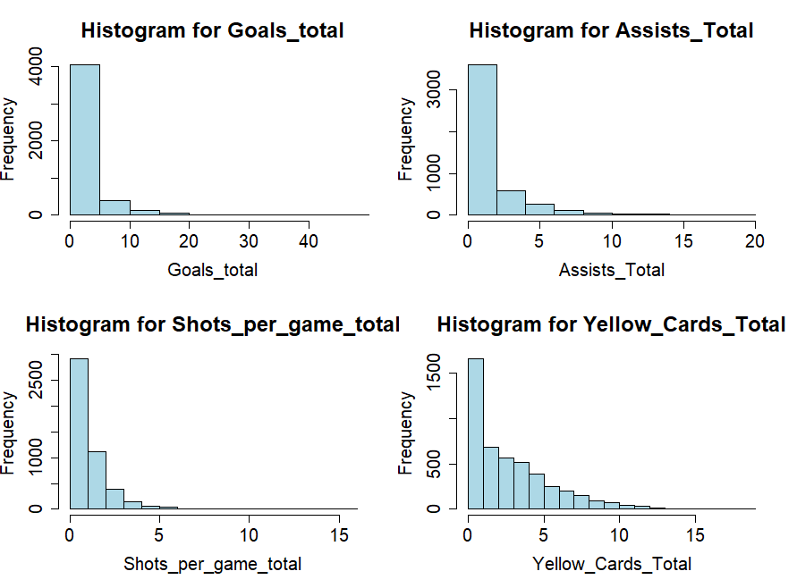
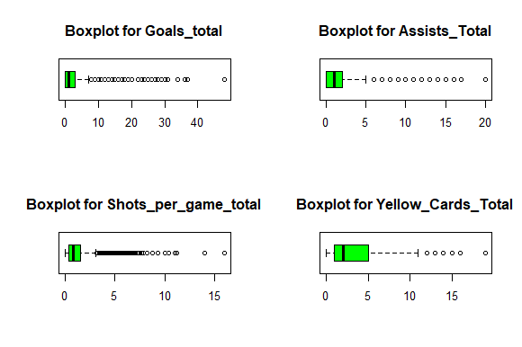
Exploratory Data Analysis (contd.)
Key Results
Most of the continuous numerical variables are not distributed normally and have outliers in them. However, some of the variables containing outliers, like Goals_Total are important, and the outliers may actually be helpful in predicting the market value of the corresponding players. Thus, it may be worthwhile to make a model without treating outliers of all variables. It is important to note that if outlier treatment is performed, it will only be done on continuous numeric variables and not the ordinal numeric variables

Slide 19
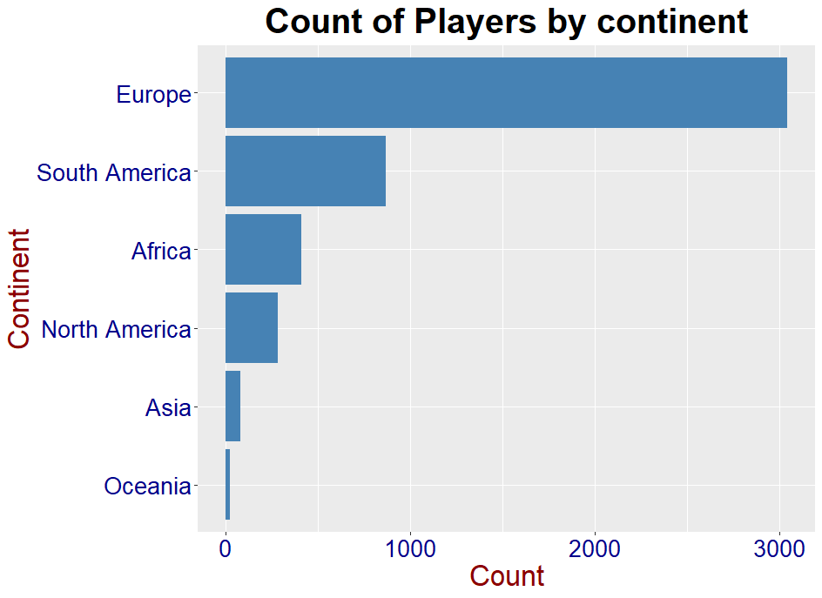
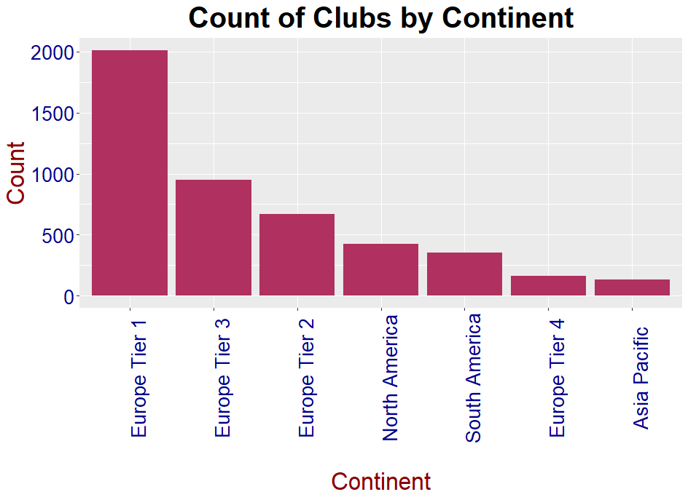
Exploratory Data Analysis (contd.)
Key Results
Looking at the barplots for the categorical variables, most of the players as well as clubs belong to Europe. As such it may help to reduce the levels of categories by clubbing the categories with lower counts into a single category

Slide 20
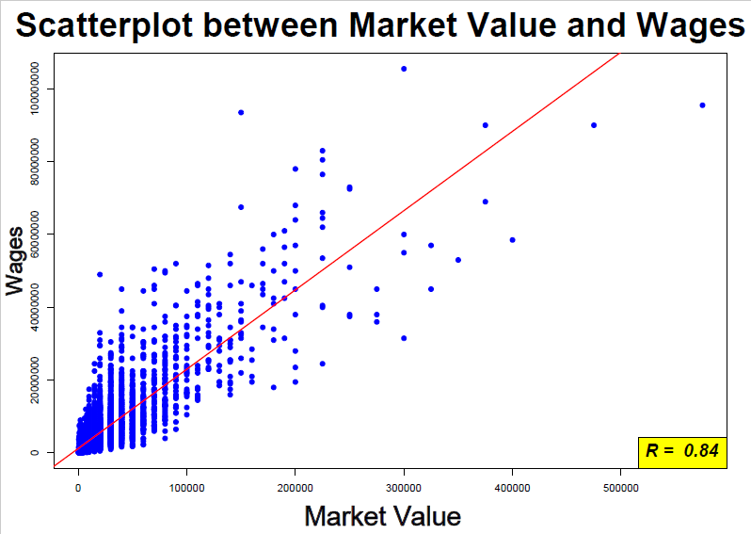
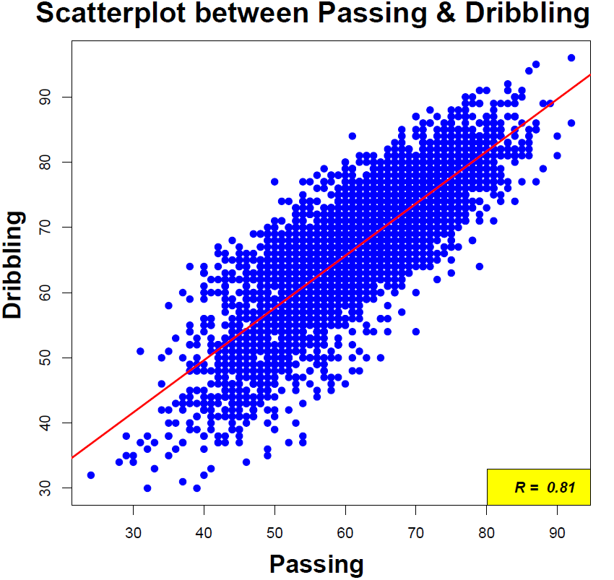
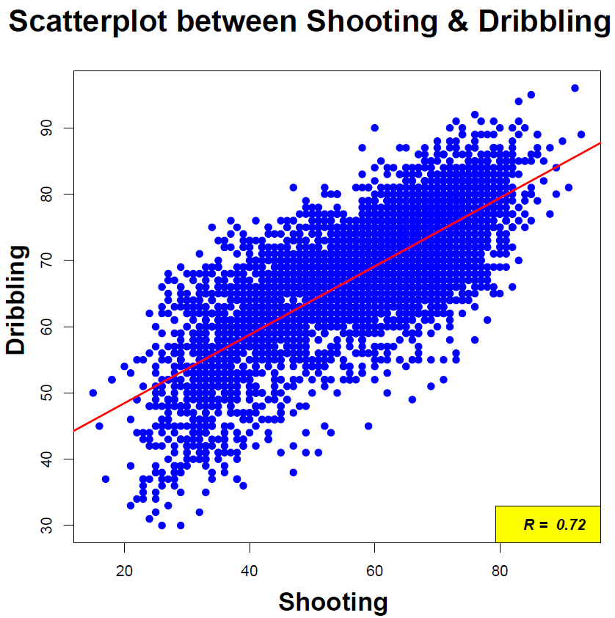
Exploratory Data Analysis (contd.)
Key Results
The correlation plots gives us important insights, the most noteworthy being the high correlation between Wages and Market Value (0.84). This is beneficial for the model as it suggests that the feature Wages has strong explanatory power about the Market Value and is likely to be an important variable in the model.
There was high correlation (>0.7) and VIF (>5) for dribbling, passing and shooting were suggestive of multicollinearity which may have to be dealt with when making the model. However, with dribbling being common variable, dropping it may be sufficient to deal with multicollinearity

Slide 21
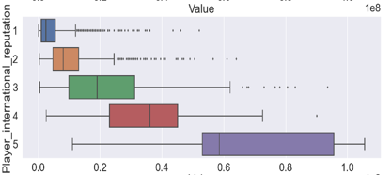
Exploratory Data Analysis (contd.)
Key Results (contd.)
Looking at the behavior of the ordinal variables with respect to the target variable, we can see that the Player’s International reputation is a good distinguisher of market value. (graph below)

Slide 22
Making the model

Slide 23
Modelling Approach
Step 1 : Identifying the models to be made
Considering that the response variable in consideration is of numerical nature and we also want to know which variables contribute the most in making the prediction, the models suitable for use are:
i. Multiple Linear Regression (MLR)
ii. Lasso Regression
iii. Ridge Regression
iv. Classification and Regression Tree (CART)
v. Random Forest (RF)
vi. Gradient Boosting Machine (GBM)
Based on our EDA results , it may be worthwhile to build the model on 3 different versions of the data –
i. The original data without any outliers treated
ii. The data with outliers treated for all variables except for Goals_Total, Assists_Total and Wages
iii. The data with outliers treated for all variables.

Slide 24

Modelling Approach (contd.)
Step 2 : Making the model and cross validating
For the purpose of making the model , the PyCaret library in Python was used which allows to build a pipeline for machine learning model. This pipeline allows to configure several options mentioned below:
Train Size: used to specify the ratio in which to split the data into train and test sets (70:30 for our model)
Target: used to specify the target variable.
Session id: used to set a seed value so that the same split of train and test data is created every time a model is made.
Categorical/numeric/ordinal features: used to specify the type of the different features in the dataset so that they are used in the correct format when making the model.
Normalize: used to normalize the non-ordinal numeric data.
Normalize method: The normalization used for our model is z-score normalization where
X_{i} = $\frac{Xi –μ }{σ}$

Slide 25
Modelling Approach (contd.)
Step 2 : Making the model and cross validating (contd.)
7. Combine Rare Levels: As noted during EDA, there were some categorical variables whereby majority of the observations fell under one level with the other levels having only a few observations. This option is used to combine the less frequent levels together.
Rare Level Threshold: This option is used to specify the threshold for considering a level as rare. For example, if the threshold is 0.1, then all levels which make up 10% or less of the total observations in that variable will be clubbed together
Fold Strategy: This option is used to perform cross validation and to specify the type of cross validation to be used. The method used for cross validation is K-Fold
Fold: Used to specify the number of folds to be used in cross validation (10 in our model)

Slide 26
Modelling Approach (contd.)
Step 3 : Checking model performance and comparing all models.
After making all the models the next final step is to check the accuracy of the model using the test data.
In order the check the accuracy of the models the following metrics were used:
Root Mean Square Error (RMSE) = √(∑( Y_{i}- Ŷ )² )/n
Mean Absolute Percentage Error (MAPE) = ((| Y_{i}- Ŷ |*100)/Y_{i})/n
Where Y_{i} is the observed (actual) value , Ŷ is the predicted value and n is the sample size
Finally, after all the models have been made and the accuracy measures have been calculated , the model with the least error rate given by RMSE and MAPE will be chosen as the best model.

Slide 27
Model Building and Results

Slide 28
Model 1 - Multiple Linear Regression
The main aim for making an MLR model was to use the slope coefficients and check the magnitude of the change in the market value of players for a unit change in each of the independent variables.
To do so, the model was first made without normalizing the variables.
However for the coefficients to be interpreted , the MLR model must satisfy the following assumptions
Linearity – There should a linear relationship between the dependent variable and each feature.
No Endogeneity – the covariance (or correlation) between the error and each independent variable should be 0.
No autocorrelation – There should be no correlation between errors. (Checked using Durbin-Watson test)
No multicollinearity – There should be no correlation between the predictor variables.
Normality and homoscedasticity - The error terms should be normally distributed (Checked using Shapiro-Wilkinson test) .Homoscedasticity means the error term should have equal variance from the mean i.e. the variance of error terms should be homogenous (checked by plotting residuals against fitted values)

Slide 29
Model 1 - Multiple Linear Regression (contd.)
The model was first made using all variables and then variables with VIF >5 were dropped one by one to deal with multicollinearity. Once all the variables had a VIF <5 , variables which were statistically insignificant (P-value > 0.01) were also dropped. The below tables shows the results:
The table above shows that none of the models satisfy the MLR assumptions and so the slope coefficients of these models are not reliable.
However , an MLR model can still be used to solely for prediction purposes even if the assumptions do not hold true.
Original Data without Outliers Treated
Model I | R² | RMSE | MAPE | Errors normally distributed ? | Errors Homoscedastic? | Multicollinearity exists ? | Is there Autocorrelation?
 | 0.81 | 7.29 | 3.98 | No | No | No | Yes
2. Original Data with Outliers Treated (excluding certain variables)
Model II | R² | RMSE | MAPE | Errors normally distributed ? | Errors Homoscedastic? | Multicollinearity exists ? | Is there Autocorrelation?
 | 0.81 | 7.37 | 4.03 | No | No | No | Yes
3. Original Data with Outliers Treated for all variables
Model III | R² | RMSE | MAPE | Errors normally distributed ? | Errors Homoscedastic? | Multicollinearity exists ? | Is there Autocorrelation?
 | 0.69 | 9.13 | 5.04 | No | No | No | Yes

Slide 30
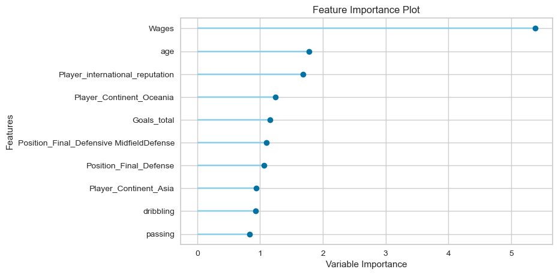
Model 1 - Multiple Linear Regression (contd.)
Since the interpretation of slope coefficients is no longer reliable , the model was made without worrying about the assumptions and by normalizing the numeric variables. Below are the accuracy results as well as a feature importance plot.
Based on the RMSE results , Model 1.B is the best MLR model. The model with outlier treatment for all variables performs the worst. Finally, looking at the feature importance plot , we can see that Wages is the most important variable followed by age and then Player_international_reputation. Two of these variables were expected to be good predictors during our initial exploratory data analysis
1. Normalized Data without Outliers Treated
Model 1.A | R² | RMSE | MAPE
 | 0.81 | 4.01 | 1.24
2. Normalized Data with Outliers Treated except for certain variables
Model 1.B | R² | RMSE | MAPE
 | 0.81 | 3.99 | 1.23
3. Normalized Data with Outliers Treated for all variables
Model 1.C | R² | RMSE | MAPE
 | 0.69 | 5.10 | 1.72

Slide 31
Model 2 - Lasso Regression
Lasso Regression shrinks the regression coefficients toward zero by penalizing the regression model with a penalty term called L1-norm which is the sum of the absolute value of the magnitude of regression coefficients
A tuning parameter, λ controls the strength of the L1 penalty. λ is basically the amount of shrinkage:
When λ = 0, no parameters are eliminated. The estimate is equal to the one found with linear regression.
As λ increases, more and more coefficients are set to zero and eliminated (theoretically, when λ = ∞, all coefficients are eliminated)
Model 3 – Ridge Regression
Ridge Regression shrinks the regression coefficients toward zero by penalizing the regression model with a penalty term called L2-norm which is the sum of the squared value of the magnitude of regression coefficients. But it does not remove the variable like Lasso does.
When λ = 0, ridge regression equals least squares regression. If λ = ∞, all coefficients are shrunk to zero. The ideal penalty is therefore somewhere in between 0 and ∞

Slide 32
Model 4 – Classification and Regression Tree (CART)
CART makes predictions based on a decision tree which consists of several root (or internal) nodes where each node corresponds to binary response in a predictor variable.
Based on the decision at each root node of the tree , a final leaf node is generated which contains a value for the dependent variable.
Important parameters for CART are :
The minimum number of samples / observations which must be taken into consideration while creating a split at every
The minimum number of samples / observations that must be in a leaf (or terminal) node.)
The maximum depth of the tree. If it is not specified, then nodes are expanded until all leaves are pure or until all leaves contain less than min_samples_split samples.
The number of features to consider when looking for the best split
The complexity parameter which indicates the threshold level of improvement at every node or i.e. the minimum improvement in the model needed at each node. For example, if cp=0.01, then the algorithm will continue to improve the model, till the improvement at every node is more than 0.01. The moment it becomes less than 0.01, the regression tree stops developing further.

Slide 33
Model 5 – Random Forest
Random Forest is a machine learning algorithm that works in the same way as CART. However instead of using just one tree , the prediction is based on multiple trees because of which it is called an Ensemble Model
The random forest approach uses a technique called bagging (standing for “bootstrap aggregating”) , whereby multiple trees are made in parallel simultaneously.
Bootstrapping is a statistical technique which consists of generating samples ,with replacement, of size B (called bootstrap samples) from an initial dataset of size N.
Also , in random forest , each bootstrap sample uses only a subset of features , and not all the features when making a decision tree.
The final result given by the Random Forest Model is an average of the results given by all the individual trees.
Since Random Forest is also a decision tree based model , it takes in all the parameters as CART. However, there are two additional important parameters to consider when making a random forest mode:
The number of trees to be built in the random forest model.
The number of variables out of the total variables, to be used while building each tree

Slide 34
Model 6 – Gradient Boosting Machine (GBM)
GBM is also Ensemble Model. However, unlike random forest which uses the technique of bagging, GBM uses a technique called Boosting.
However unlike bagging , boosting does not build the family of trees parallelly. Instead boosting considers homogeneous weak learners and learns them sequentially (a base model depends on the previous ones)
Each model in the sequence is fitted giving more importance to observations in the dataset that were badly handled by the previous models in the sequence. Intuitively, each subsequent model focuses its efforts on the most difficult observations to fit up to now, so that we obtain, at the end of the process, a strong learner.
GBM redefines boosting as a numerical optimization problem where the objective is to minimize the loss function of the model (which gives the error) by adding weak learners using gradient descent. Gradient descent involves finding local minimum of a differentiable function i.e. the first-order derivative
Just like Random Forest , Gradient Boosting also takes all parameters of CART. The only major difference in the parameters to be specified is that instead of specifying the number of trees to be made as in Random Forest , we need to specify the number of boosting stages to perform.

Slide 35
Results for all models
Linear Regression
1. Normalized Data without Outliers Treated
Model 1.A | R² | RMSE | MAPE
 | 0.81 | 4.01 | 1.24
2. Normalized Data with Outliers Treated except for certain variables
Model 1.B | R² | RMSE | MAPE
 | 0.81 | 3.99 | 1.23
3. Normalized Data with Outliers Treated for all variables
Model 1.C | R² | RMSE | MAPE
 | 0.69 | 5.10 | 1.72
Lasso Regression
1. Normalized Data without Outliers Treated
Model 2.A | R² | RMSE | MAPE
 | 0.81 | 4.01 | 1.27
2. Normalized Data with Outliers Treated except for certain variables
Model 2.B | R² | RMSE | MAPE
 | 0.81 | 3.99 | 1.27
3. Normalized Data with Outliers Treated for all variables
Model 2.C | R² | RMSE | MAPE
 | 0.69 | 5.10 | 1.76
Ridge Regression
1. Normalized Data without Outliers Treated
Model 3.A | R² | RMSE | MAPE
 | 0.81 | 4.00 | 1.24
2. Normalized Data with Outliers Treated except for certain variables
Model 3.B | R² | RMSE | MAPE
 | 0.81 | 3.99 | 1.23
3. Normalized Data with Outliers Treated for all variables
Model 3.C | R² | RMSE | MAPE
 | 0.69 | 5.10 | 1.72
CART
1. Original Data without Outliers Treated
Model 4.A | R² | RMSE | MAPE
 | 0.79 | 4.22 | 0.58
2. Original Data with Outliers Treated except for certain variables
Model 4.B | R² | RMSE | MAPE
 | 0.79 | 4.22 | 0.44
3. Original Data with Outliers Treated for all variables
Model 4.C | R² | RMSE | MAPE
 | 0.76 | 4.47 | 0.50
Random Forest
1. Original Data without Outliers Treated
Model 5.A | R² | RMSE | MAPE
 | 0.89 | 3.10 | 0.34
2. Original Data with Outliers Treated except for certain variables
Model 5.B | R² | RMSE | MAPE
 | 0.89 | 3.11 | 0.34
3. Original Data with Outliers Treated for all variables
Model 5.C | R² | RMSE | MAPE
 | 0.88 | 3.17 | 0.34
GBM
1. Original Data without Outliers Treated
Model 6.A | R² | RMSE | MAPE
 | 0.93 | 2.44 | 0.37
2. Original Data with Outliers Treated except for certain variables
Model 6.B | R² | RMSE | MAPE
 | 0.92 | 2.58 | 0.35
3. Original Data with Outliers Treated for all variables
Model 6.C | R² | RMSE | MAPE
 | 0.92 | 2.66 | 0.34

Slide 36
Results for all models (contd.)
The Linear, Lasso and Ridge Regression models all give very similar results. For each of these algorithms, the model made with outlier treatment for all variables is much weaker as compared to the models where no or limited outlier treatment was done.
In fact, in all of the 6 algorithms used, the model with outlier treatment for all variables gives the least accurate predictions
One major difference between the Regression and Decision Tree models is that, in case of the latter, all three methods of outlier treatment give very close results, which is not the case with the regression models.
This is because tree-based models are robust to outliers.
Thus, if outliers are important to be incorporated in the model, as is the case in our problem, then a tree-based model is more reliable.

Slide 37
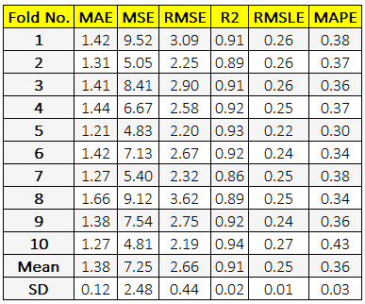
Best Model
The best model of all the models made is model 6.A which is the GBM model without any outlier treatment. It has the highest R squared value which means, using the given features, it is able to explain the variation in the market value of players to the maximum extent. This model also gives the least values of RMSE and MAPE and hence the best accuracy when making the predictions.
Below are the Cross Validation (left) and accuracy (right) results for this model :
Train data results
We can see that the mean RMSE and MAPE values for all the folds are very close to each other.
Further the RMSE and MAPE results from the train data (i.e. the mean RMSE and MAPE of all the folds) are very close to those of the test data suggesting the model is stable.
Test data results
GBM
1. Original Data without Outliers Treated
Model 6.A | R² | RMSE | MAPE
 | 0.93 | 2.44 | 0.37

Slide 38
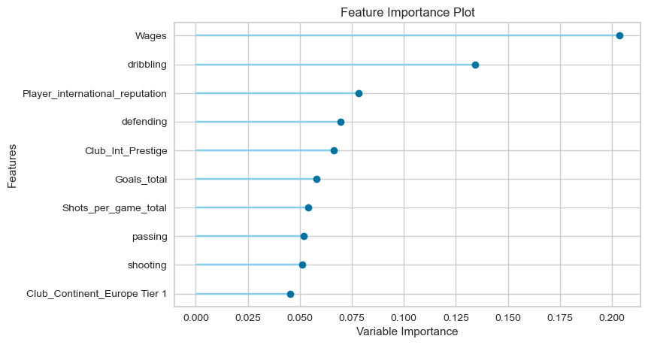
Best Model (contd.)
Below is the feature importance plot for the GBM model 6.A
Looking at the feature importance plot Wages are given the highest importance when making the prediction, followed by dribbling and then Player_international_reputation. Two of these variables were expected to be significant in making the prediction when performing the initial exploratory data analysis.

Slide 39
Conclusion and Recommendations

Slide 40
The gradient boosting machine model gave the best results managing to explain 93% of the variation in the football players’ market value.
The result from the model did not swerve considerably from the current market value. The mean deviation was around €2.5 million which is marginal compared to the huge market value of players.
The model that has been built can be used by a football club to determine how much money to bid when considering buying a player from another club.
Added to that , the model also indicates what information about the player is most likely to be important when determining the value of such a bid. Since the feature importance plot shows Wages to be the most important variables in predicting the market value, this is the first piece of information that the club should aim to gather when considering buying a new player.
Although the model has incorporated 93% of the market prediction, commercial giants have the resources to capture many more metrics per player per game which may not necessarily be available on the internet and thus may be able improve the accuracy of the model even further.
The application of this model is not limited to just football players. The theory can be extended to any sort of competition or sport which involves the buying and selling of sportspersons.
An example is the Indian Premier League which is the world’s most popular cricketing competition involving privately owned clubs. Similar to the transfer window , the IPL has a bidding process before the beginning of every season. By collecting attributes of the participating cricket players, the owners of the club can make a bid based on the player’s actual performance and in this way they may be able to prevent themselves from overspending on certain players.

Slide 41
Thank You

